Slide 1
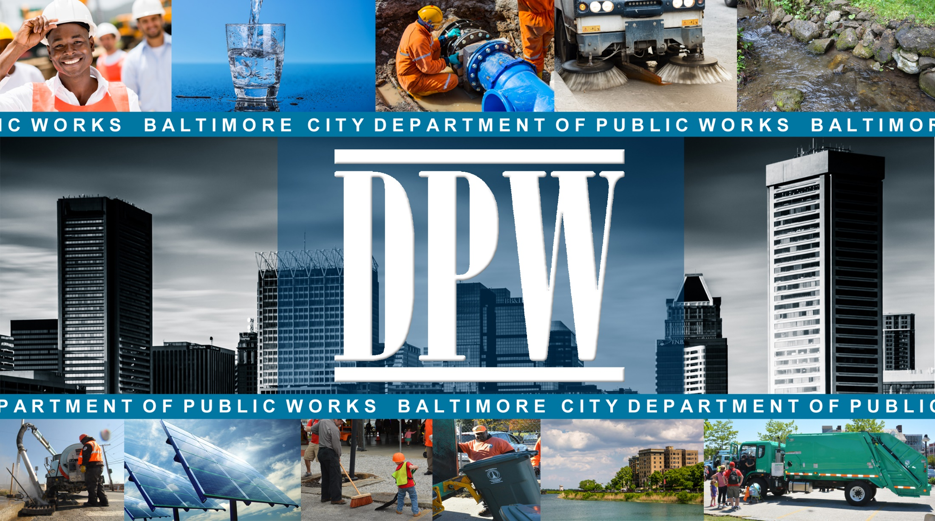
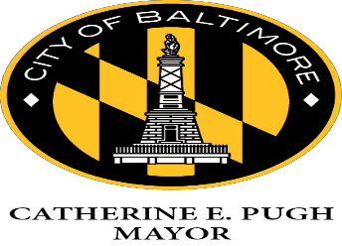

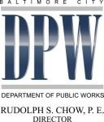
Fiscal Year 2020
Design & Construction Projects

Slide 2

Department of Public Works
OUR MISSION
We support the health, environment, and economy
of our City and the region
by providing customers
with safe drinking water
and keeping neighborhoods and waterways clean.
OUR VISION
To be a strong proponent and protector
of our environment
and the health and vitality
of our communities.
Baltimore City Department of Public Works

Slide 3
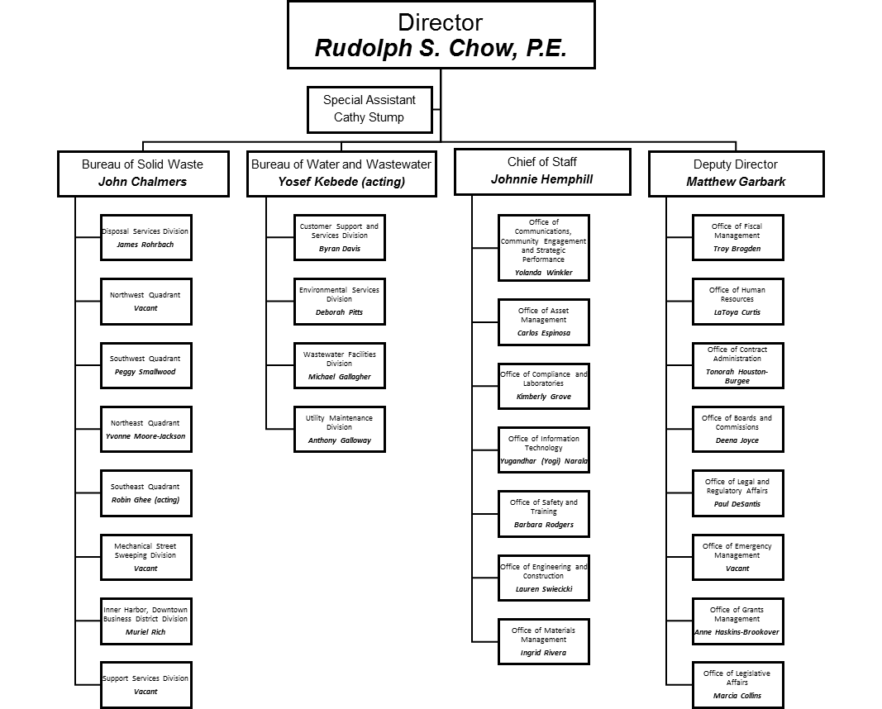
DPW Organizational Chart

Slide 4

FY 2020 Capital Improvement Program
Stormwater
Environmental Services
Wastewater
Water
520
$
11.27M
M
525
$
5.8M
551
$
176.03MM
557
$
165.1M
Capital Improvement Program Total
$
358.2M
Baltimore City Department of Public Works

Slide 5
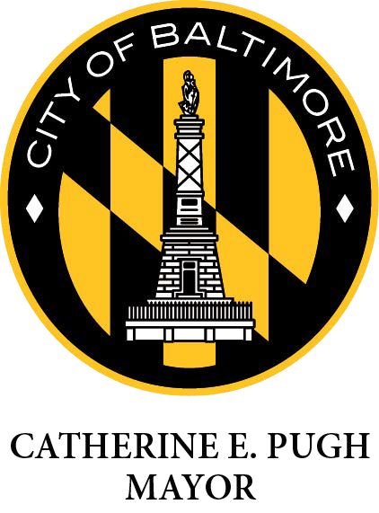
Program 520: Stormwater
Program 525: Environmental Services
Design Projects - Stormwater
Contract | Project Name | Advertisement | Estimated Range
1319 | Stormwater Hydraulic Model development project | FY 2020, Q2 | $3.5M - $4.0M
Construction Projects - Stormwater
Contract | Project Name | Advertisement | Estimated Range
SDC 7768 | Harris Creek Watershed | FY 2020, Q2 | $15.0M - $20.0M
Construction Projects - Environmental Services
Contract | Project Name | Advertisement | Estimated Range
ER 4130R | Environmental Restoration Project 14 | FY 2020, Q3 | $1.0M - $2.0M
ER 4126 | Environmental Restoration Project 10 | FY 2020, Q4 | $3.0M - $4.0M
ER 4129 | Environmental Restoration Project 13 | FY 2020, Q3 | $2.0M - $3.0M
ER 4124 | Maidens Choice & Dead Run Stream Restorations | FY 2020, Q2 | $3.0M - $4.0M
ER 4040 | Moore’s Run Environmental Restoration | FY 2020, Q4 | $6.0M - $7.0M
Baltimore City Department of Public Works

Slide 6
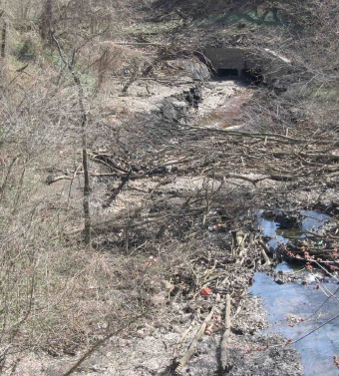
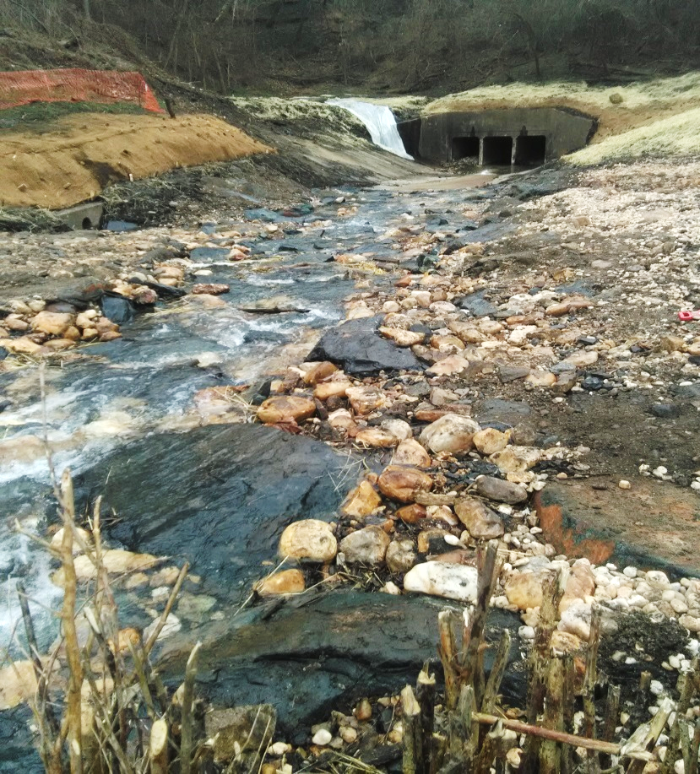
Program 525: Environmental Services
ER 4020R Lower Lower Stony Run Stream Restoration
Before
After
Baltimore City Department of Public Works

Slide 7
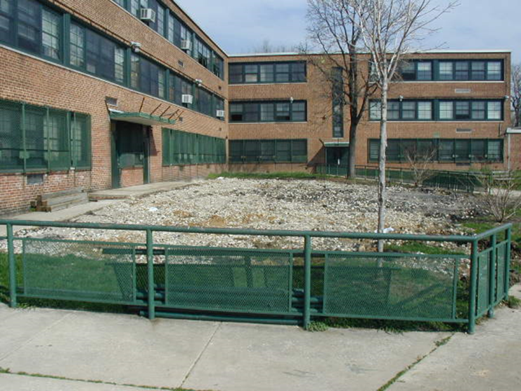
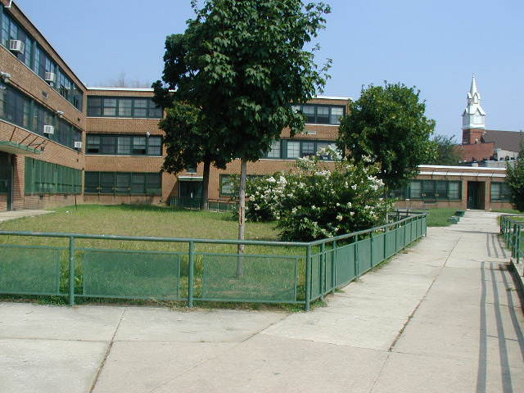
Program 525: Environmental Services
Environmental Restoration Projects Lot Greening
Before
After
Baltimore City Department of Public Works

Slide 8
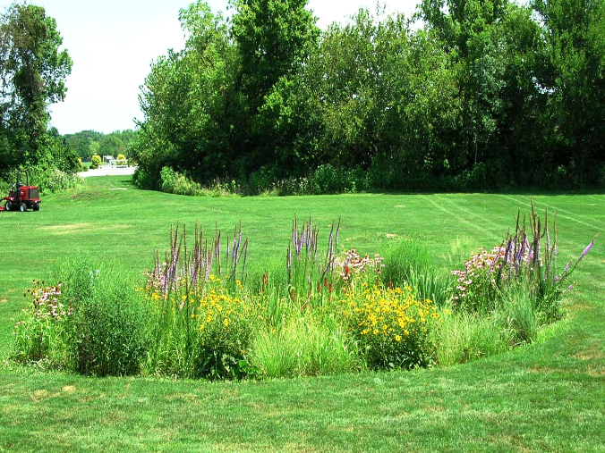
Program 525: Environmental Services
Environmental Restoration Projects – Environmental Site Designs
Stormwater Bumpout
Bioretention
Baltimore City Department of Public Works

Slide 9
Program 551: Wastewater
Construction Projects - Wastewater Utilities
Contract | Project Name | Advertisement | Estimated Range
SC 866 | Replacement of the Southwest Diversion Pressure Sewer - Phase 1 | FY 2020, Q4 | $50.0M - $55.0M
SC 985 | Herring Run System Improvements Part 1 | FY 2020, Q4 | $15.0M - $20.0M
SC 978 | Small Sewer Upgrades in Roland Park Area | FY 2020, Q4 | $5.0M - $10.0M
SC969 | Improvements to Horner’s lane Siphon Across Armstead Run | FY 2020, Q4 | $5.0M - $10.0M
Baltimore City Department of Public Works

Slide 10

Program 551: Wastewater
Construction Projects - Wastewater Facilities
Contract | Project Name | Advertisement | Estimated Range
SC 954 | Back River Primary Settling Tanks 3 and 4 Rehabilitation | FY 2020, Q4 | $16.0M - $18.0M
SC 957 | Arc Flash Rehabilitation at Pump Stations | FY 2020, Q2 | $5.0M - $6.0M
SC 982 | Eastern Avenue Pump Station Rehabilitation | FY 2020, Q4 | $12.0M - $16.0M
SC 983 | Patapsco Primary Settling Tank Scum Collection System Improvements | FY 2020, Q2 | $3.0M - $3.5M
SC 993 | Jones Falls Pump Station | FY 2020, Q3 | $5.0M - $7.0M
Baltimore City Department of Public Works

Slide 11
Program 551: Wastewater
Design Projects - Wastewater Facilities
Contract | Project Name | Advertisement | Estimated Range
SC 979 | Dundalk Pump Station Rehabilitation | FY 2020, Q2 | $0.5M - $1.0M
SC 986 | Back River Deep Manhole Primary Sludge Thickener | FY 2020, Q4 | $0.5M - $1.0M
SC 988 | Patapsco Secondary Reactor Rehabilitation | FY 2020, Q3 | $3.0M - $4.0M
SC 990 | Patapsco Administration Building Rehabilitation | FY 2020, Q2 | $1.0M - $1.5M
SC 991 | Patapsco Liquid Oxygen Plant Rehabilitation | FY 2020, Q3 | $1.0M - $1.5M
SC 994 | Patapsco Clarifier and Thickener Rehabilitation | FY 2020, Q3 | $0.5M - $0.6M
SC TBD | Back River Rapid Sludge Loading | FY 2020, Q4 | $0.5M - $1.0M
SC TBD | Back River Activated Plant 3 Clarifiers Rehabilitation | FY 2020, Q4 | $1.0M - $2.0M
SC TBD | Quad Avenue Station Rehabilitation | FY 2020, Q4 | $0.4M - $0.5M
Baltimore City Department of Public Works

Slide 12
Program 551: Wastewater
Design Projects cont. - Wastewater Facilities
Contract | Project Name | Advertisement | Estimated Range
SC TBD | Patapsco Low Lift Station | FY 2020, Q4 | $1.0M - $1.5M
SC TBD | Back River Scale House Replacement | FY 2020, Q4 | $0.2M - $0.3M
SC TBD | Back River Miscellaneous Rehabilitation | FY 2020, Q4 | $1.0M - $1.5M
SC TBD | Patapsco Miscellaneous Rehabilitation | FY 2020, Q4 | $2.0M - $2.5M
Baltimore City Department of Public Works

Slide 13
Program 557: Water
Construction Projects - Water Utilities
Contract | Project Name | Advertisement | Estimated Range
WC 1274 | Carrollton Ave & Vicinity Water Main Replacement | FY 2020, Q2 | $5.0M - $10.0M
WC 1285 | Caroline St & Vicinity Water Main Replacement | FY 2020, Q2 | $10.0M - $15.0M
WC 1291 | Wilken Ave / Frederick Ave & Vicinity WM Replacement | FY 2020, Q2 | $10.0M - $15.0M
WC 1252 | Grantley Rd & Vicinity Water Main Replacement | FY 2020, Q3 | $5.0M - $10.0M
WC 1275 | Ellamont St/ Springlake Way &Vicinity WM Replacement | FY 2020, Q3 | $10.0M - $15.0M
WC1284 | Brewers Hill Neighborhood Water Main Replacement | FY 2020, Q3 | $5.0M - $10.0M
WC1288 | WM Replacement in Beechfield, Yale Heights & Vicinity | FY 2020, Q4 | $5.0M - $10.0M
WC1290 | Downtown Area & Madison St Water Main Replacement | FY 2020, Q4 | $5.0M - $10.0M
WC1316 | Barclay Neighborhood & Vicinity WM Replacement | FY 2020, Q4 | $15.0M - $20.0M
Baltimore City Department of Public Works

Slide 14
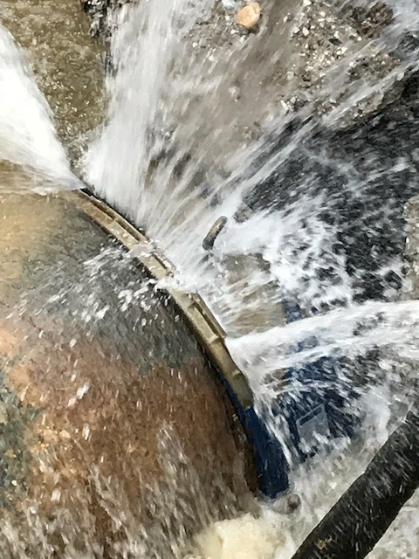
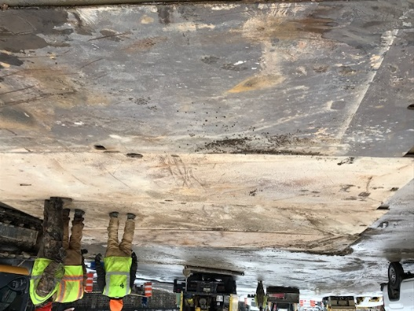
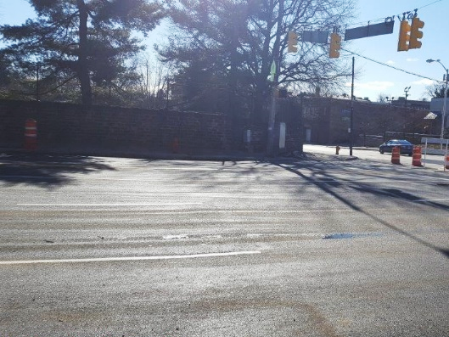
Program 557: Water
Construction Projects - Water & Stormwater Utilities, Urgent Needs
Contract | Project Name | Advertisement | Estimated Range
WC 1404 | Water Infrastructure Rehabilitation/Improvements Phase III | FY 2020, Q2 | $7.0M - $8.0M
WC TBD | Water Infrastructure Rehabilitation/Improvements Phase I | FY 2020, Q4 | $7.0M - $8.0M
SDC 7778 | Drainage Repairs and Improvements at various locations | FY 2020, Q2 | $3.0M - $4.0M
Baltimore City Department of Public Works

Slide 15
Program 557: Water
Construction Projects - Water Facilities
Contract | Project Name | Advertisement | Estimated Range
WC 1229 | Vernon Pump Station Rehabilitation | FY 2020, Q3 | $40.0M - $45.0M
WC 1354 | Ashburton Washwater Lake Dredging | FY 2020, Q3 | $5.0M - $6.0M
WC 1382 | Montebello I FWR Structural Rehabilitation | FY 2021, Q3 | $6.0M - $7.0M
WC 1395 | Montebello WFP 2 Dehumidification Improvements | FY 2020, Q4 | $2.5M - $3.0M
WC 1396 | Montebello WFP 2 Sedimentation Basins | FY 2021, Q1 | $5.0M - $6.0M
WC 1397 | Montebello II Control Panel Replacement | FY 2021, Q2 | $1.0M - $2.0M
Baltimore City Department of Public Works

Slide 16
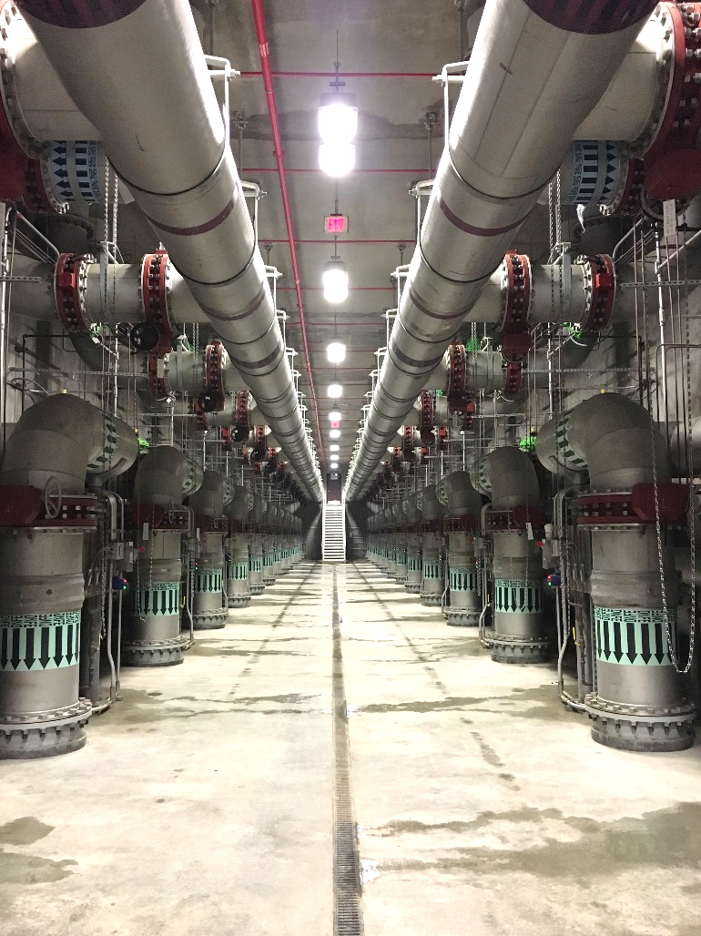
DPW Office of Engineering and Construction
Lauren Swiecicki, P.E., Chief
lauren.swiecicki@baltimorecity.gov
Azzam Ahmad, Water & Wastewater Utilities
azzam.ahmad@baltimorecity.gov
Tracy Moffatt, Environmental Engineering
tracy.moffatt@baltimorecity.gov
Gurminder Singh, Water & Wastewater Facilities
gurminder.singh@baltimorecity.gov
Wazir Qadri, Urgent Needs
wazir.qadri@baltimorecity.gov
Cristina Baltazar, P.E, Project Controls
cristina.baltazar@baltimorecity.gov
Baltimore City Department of Public Works

